Slide 1
omegalib

Slide 2
VR system development
Heterogeneous applications
Need custom software/library stack depending on scenario

Slide 3
What is omegalib
Design objectives:
Build / run out of the box
Support clustered and multi-gpu systems
works

Slide 4
Concept
Front-ends
Osg
Vtk
…
Abstraction layer
Display system
Event services
Back-ends
Equalizer
Controllers
Kinect
Glut
VRPN devices
…

Slide 5
Library structure: omicron
omicron
https://code.google.com/p/omicron-sdk/
Event Services
Config files, Xml, Threading, Math
omicronConnector
simplify integration of input support into third party C++ code.
Header only: Just need to include one single header
Streamlined binary event format

Slide 6
omicronConnector sample
#include <connector/omicronConnectorClient.h>
using namespace omicronConnector;
int main(int argc, char** argv)
{
OmicronConnectorClient<ConnectorListener> client;
client.connect("127.0.0.1");
while(true) client.poll();
}
class ConnectorListener
{
public:
static void onEvent(const EventData& e) { printf(“Received event!\n”); }
};

Slide 7
New Binary event format
0 | 8 | 16 | 24
timestamp | Source ID | Service ID | Service Type
Event Type | Flags | Position X | Position Y
Position Z | Orientation W | Orientation X | Orientation Y
Orientation Z | Extra Data Type | Extra Data Length | Extra Data …
…
Old protocol available through LegacyNetService, legacy-oinputserver
Same Handshake
Same Transport

Slide 8
Library structure: omega
omega
Display system
Multi-Gpu resource management
Basic scenegraph
Python scripting
omegaToolkit
Obj loaders, gui widgets, other utilities
omegaOsg
Osg integration
omegaVtk
Vtk integration (experimentl)

Slide 9
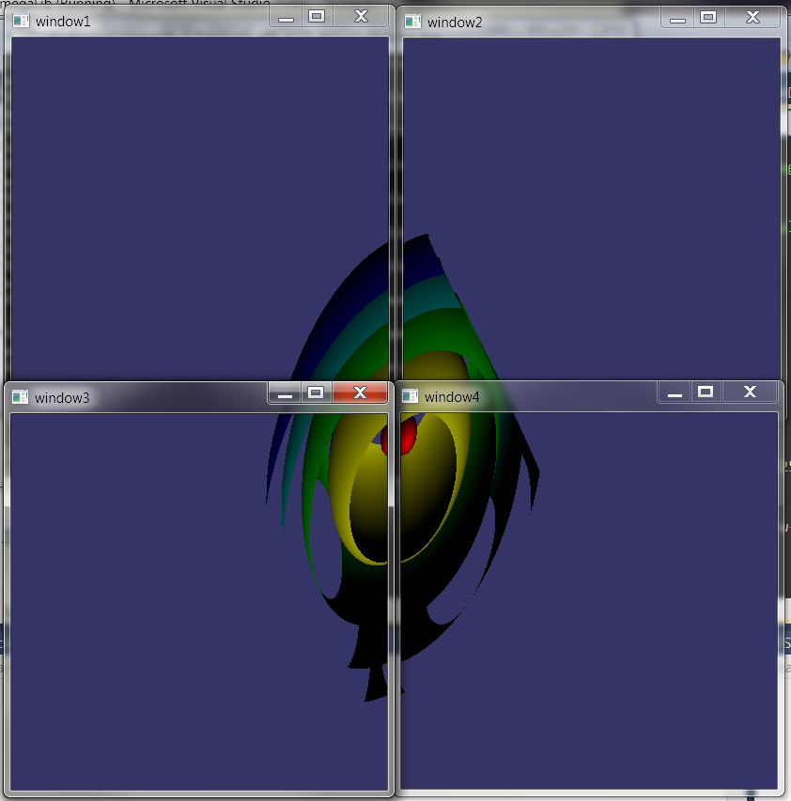
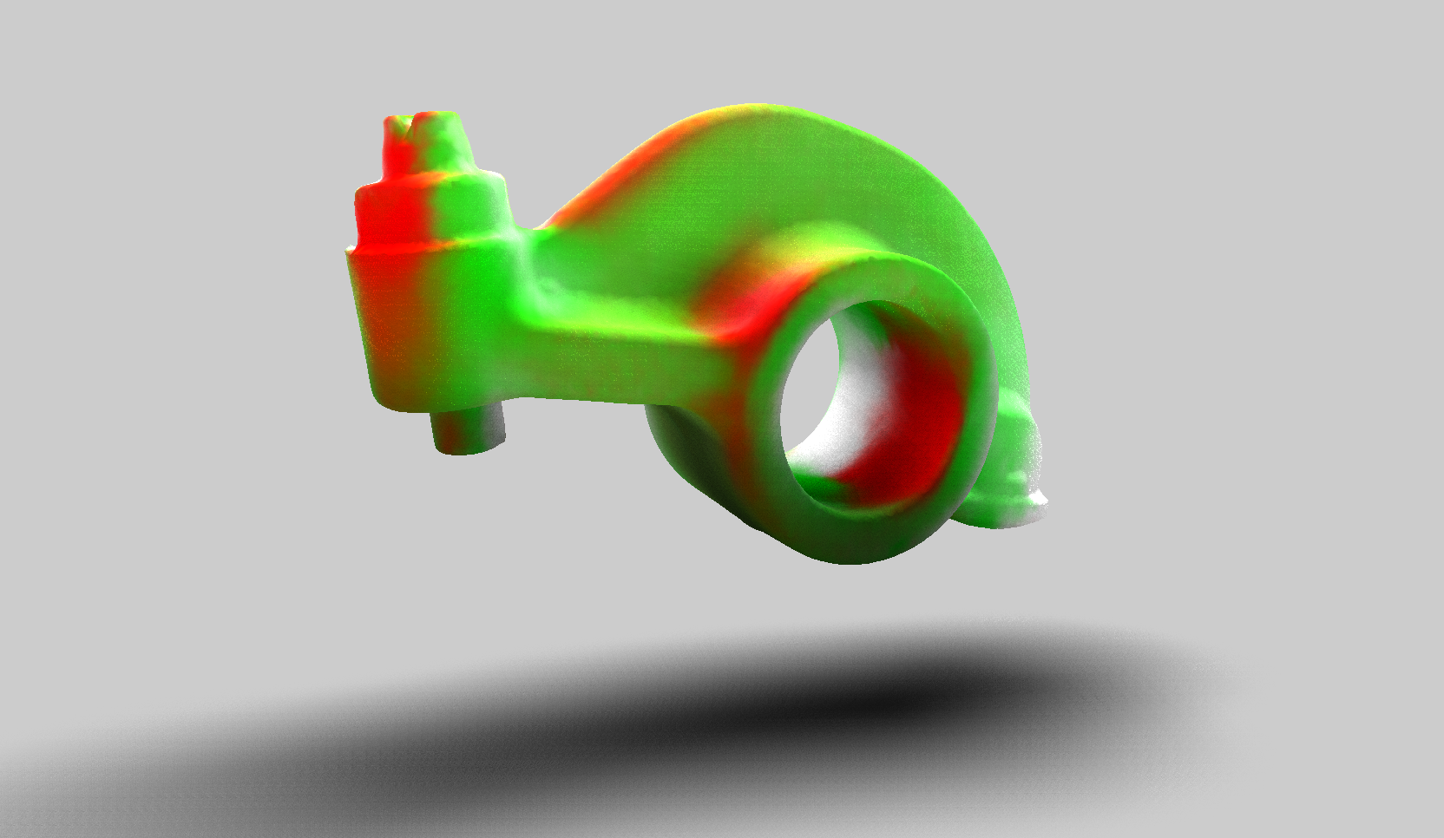
Samples
Ohello (openGl)
Meshviewer (obj loader)
Cyclops (osg)
Nightfield (OpenCl)
Vtk viewer

Slide 10
Tcp connection flow
TcpServer
start
accept
doCreateConnection
createConnection
>
push connection to clients
acceptor->asyncAccept
handleAccept
>
poll
>
TcpConnection
[new]
doHandleConnected
set state to ConnectionOpen
handleConnected
poll
is state = open?
is data available?
handleData
is socket closed?
handleClosed

